Slide 1

ASSORTING THE WEB NEWS WITH THE APPLICATIONS OF MACHINE LEARNING ALGORITHMS
Under the Esteemed Guidance of Presented By
T.Rajasri M Mounika (17B91A1294)
Assistant Professor L Lakshmi Sravani (17B91A1285)
M Divija (17B91A1297)
MD FAIROJUNNISA (17B91A12A3)

Slide 2
CONTENTS:
Abstract
Introduction
Objective
Problem Statement
Existing System
Proposed System
Hardware and Software Requirements
Literature Survey
Architecture
Modules
Implementation
Results
Merits and Demerits
Conclusion and Future Scope
References

Slide 3
Abstract:
Along with the increase in internet facilities and Mobile phones, exchanging of information is in huge scale. One of the major data exchanging sources is web applications. Handling of this huge data with existing machine learning methodologies reduce the time complexity and makes it cost effective compared with conventional methods. So using those methods, web news documents are classified into different categories like business , entertainment , Sports, politics and technology.
First of all the news document undergoes some text pre-processing to reduce noise and computation cost. Next we apply the feature selection onto the document to further separate important words and less important words inside the document .After applying feature selection the document is classified by the classifier. Then comparison between ML algorithms like SVM, KNN and LSTM is done. Among these the LSTM gives more accuracy.

Slide 4
Introduction:
News information was not easily and quickly available until the beginning of last decade. But now, news is easily accessible via content providers such as online news services. A huge amount of information exists in form of text in various diverse areas, whose analysis can be beneficial in several areas. Classification is quite a challenging field in text mining, as it requires prepossessing steps to convert unstructured data to structured information. With the increase in the number of news it has got difficult for users to access news of his web, which makes it a necessity to categorize the news, so that it could be easily accessed. Categorization refers to grouping that allows easier navigation among articles. Web news needs to be divided into categories. This will help users to access the news of their web in real-time without wasting any time. When it comes to news it is much difficult to classify, as news are continuously appearing that need to be processed and those news could be never-seen-before and could fall in a new category. In this paper a review of news classification based on its contents is presented . For classification we are using ML and DL algorithms like SVM , KNN and LSTM.

Slide 5
Objective:
The main objective of this project is to -
Classifying the web news documents into different categories like entertainment, politics, sports, business and technology using Algorithms like SVM,KNN and LSTM .We will find the efficient algorithm among them using classification metrics.

Slide 6
Problem Statement:
In general Identification of the type of text by human in huge data is very difficult, It takes lot of time and work. On the other hand Machine Learning algorithms like SVM, KNN and LSTM make it easier to classify within less amount of time and with accurate results.

Slide 7
Existing System:
In Existing System, machine learning methodologies reduce the time complexity and makes it cost effective compared with conventional methods. Web applications are regarded as a popular platform to exchange information with users. These applications have to be able to process Big-Data quickly and to serve users in a timely manner with accurate information posted in news portals which can be a huge challenge to overcome. Huge computation power is needed to crawl the web and process big-data and the methods are needed to be developed to reduce space and time complexity of this process.

Slide 8
Proposed System:
This paper proposes an efficient model for web that extracts news information and sorts news articles into five different categories business, technology , entertainment , sports and politics. First of all the news article undergoes some text preprocessing to reduce noise and computation cost. Next we apply the feature selection onto the article to further separate important words and less important words inside the article. After applying feature selection the article is classified by the classifier. Then comparison between ML algorithms like SVM, KNN and LSTM is done. Among these the LSTM gives more accuracy.

Slide 9
Hardware Requirements:
PROCESSOR : Intel® Core™ i5 processor at 2.60 GHz or 2.59 GHz.
HARD DISK : 1TB
RAM : 4 GB

Slide 10
Software Requirements:
OPERATING SYSTEM : Window 7/8/10, Linux
Chrome browser
TECHNOLOGIES AND TOOLS :
Python 3.7.2 and above
NLP packages
Machine Learning Module

Slide 11
Literature Survey
Thorsten Joachims[3] introduces support vector machines for text categorization. It provides both theoretical and empirical evidence that SVMs are very well suited for text categorization.The paper considers the problem of automated categorization of web sites for systems used to block web pages that contain inappropriate content. In the paper we applied the techniques of analysis of the text, html tags, URL addresses and other information using Machine Learning and Data Mining methods. Besides that, techniques of analysis of sites that provide information in different languages are suggested. Architecture and algorithms of the system for collecting, storing and analyzing data required for classification of sites are presented. Results of experiments on analysis of web sites’ correspondence to different categories are given. Evaluation of the classification quality is performed. The classification system developed as a result of this work is implemented in F-Secure mass production systems performing analysis of web content.

Slide 12
Literature Survey
Xindong Wu presents the top 10 data mining algorithms .C4.5 ,k-means, SVM, Apriori , EM, page rank, AdaBoost, kNN, Naïve Bayes and CART. These top 10 algorithms are among the most influential data mining algorithms in the research community. This paper presents the top 10 data mining algorithms identified by the IEEE International Conference on Data Mining (ICDM) in December 2006: C4.5, k-Means, SVM, Apriori, EM, PageRank, AdaBoost, kNN, Naive Bayes, and CART. These top 10 algorithms are among the most influential data mining algorithms in the research community. With each algorithm, we provide a description of the algorithm, discuss the impact of the algorithm, and review current and further research on the algorithm. These 10 algorithms cover classification, clustering, statistical learning, association analysis, and link mining, which are all among the most important topics in data mining research and development.

Slide 13
Architecture:
Preprocessing
Row of English
Articles
Tokenizing
Stopwords
WORD
Frequency
Lemmatization
Feature Extraction
Building Models
SVM,KNN and LSTM
Classifying the
Text Data
Identify The
Efficient
Model

Slide 14
MODULES USED:
Data Preprocessing
Tokenization
Stop Word Removal
Lemmatization
Label Encoding
Feature Extraction
Word Frequencies
Building models svm ,knn and lstm.
classifying text data
identify the efficient models

Slide 15
Modules Used:
Data Preprocessing
Data preprocessing is an integral step in Machine Learning as the quality of data and the useful information that can be derived from it directly affects the ability of model to learn therefore, it is extremely important that preprocess data before feeding it into our model.
Tokenization
Given a character sequence and a defined article unit (blurb of texts), tokenization is the task of chopping it up into pieces, called tokens, perhaps at the same time throwing away certain characters/words, such as punctuation.
Stop Word Removal
A stop word is a commonly used word (such as “the”, “a”, “an”, “in”) that a search engine has been programmed to ignore, both when indexing entries for searching and when retrieving them as the result of a search query. Example In the list of tokens [“Machine” ,”Learning” ,”makes” ,”benefit” ,”to” ,”humans”] we remove “to” because which does not contribute to the meaning of the sentence.

Slide 16
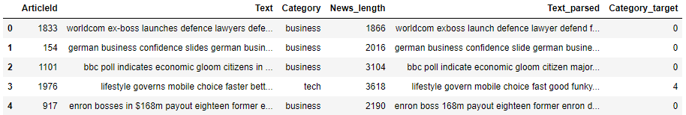
Modules Used:
Lemmatization
Lemmatization is found to be more powerful and organized as compared to stemming as it uses dictionaries which are formed using in depth linguistic knowledge. It helps to obtain better features as compared to stemming. demonstrates an example of lemmatization where different words ‘Likes’, ‘Liked ‘, ‘Likely’, ‘Liking’ are all converted into its base word ‘Like’ by slicing off the suffixes.
Label Encoding
Machine learning models require numeric features and labels to provide a prediction. For this reason we must create a dictionary to map each label to a numerical ID. We have created this mapping scheme:

Slide 17
Modules Used:
Feature Extraction
Machine Learning algorithms learn from a pre-defined set of features from the training data to produce output for the test data. But the main problem in working with language processing is that machine learning algorithms cannot work on the raw text directly. So, we need some feature extraction techniques to convert text into a matrix(or vector) of features.
One of the most popular method of feature extraction is :
TF-IDF
Word Frequencies
Word Frequencies are used to find the frequency of different words present in the articles.
Building models svm ,knn and lstM
We have used machine learning models to figure out which one may fit better to the data and properly capture the relationships across the points and their labels. We have only used classic machine learning algorithms and one deep learning algorithms,and the overall steps involved in those algorithms are discussed.We have tried the following models:SVM,KNN and LSTM.

Slide 18
Modules Used:
Classifying text data
After Building the models with the training data and fitting the model to this training data, we need to evaluate its performance on totally unseen data (the Dataset). When dealing with classification problems, there are several metrics that can be used to gain insights on how the model is performing. Some of them are Accuracy,Recall,Precision and F1 score.
Identify the efficient models
From the results of the classification metrics we can say that LSTM is the efficient model compared with models SVM and KNN .

Slide 19
IMPLEMENTATION:
Initially consider a dataset of columns like web news text and category etc..
The above data set undergoes to preprocessing such as
Checking null values, category balancing.
Tokenization is performed for
Removal of punctuations, special characters like ‘\n’ , ‘\r’, ‘-’, etc
Removal of stop words.
Performing Text Normalization using Lemmatization.
Now label encoding is performed.
Apply Tf-idf vectorizer to each and every word of independent feature such that for every unique word in our document a vector of float type is assigned. Now these Tf-idf values of each token is given as input to the classifiers.
Data is split into training and test data.
Now the below Models are built, trained with training data.
SVM
KNN
LSTM
Predict the results for our test data using above models.
Finally identifying the efficient model .

Slide 20
OUTPUT :
ALGORITHM | Accuracy (In percent) | Precision (In percent) | Recall (In percent) | F1-Score (In percent)
KNN | 91.15 | 91.15 | 91.15 | 91.15
SVM | 93.02 | 93.02 | 93.02 | 93.02
LSTM | 97.31 | 97.31 | 97.31 | 97.31

Slide 21
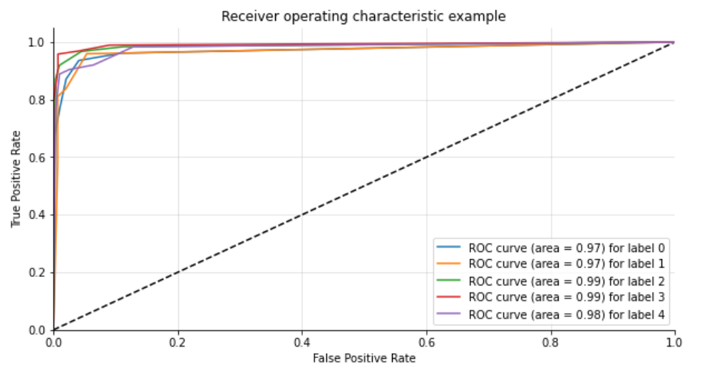
ROC Curve Of KNN :

Slide 22
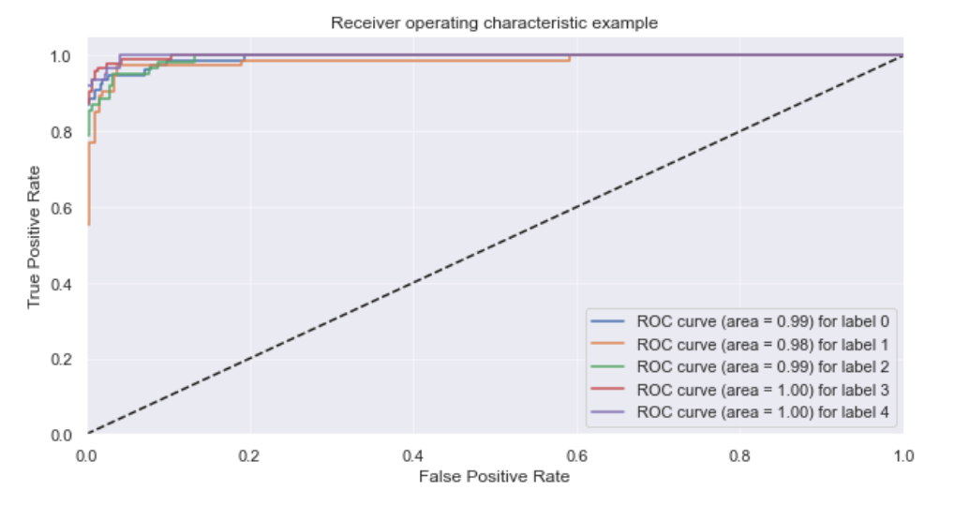
ROC Curve Of SVM :

Slide 23
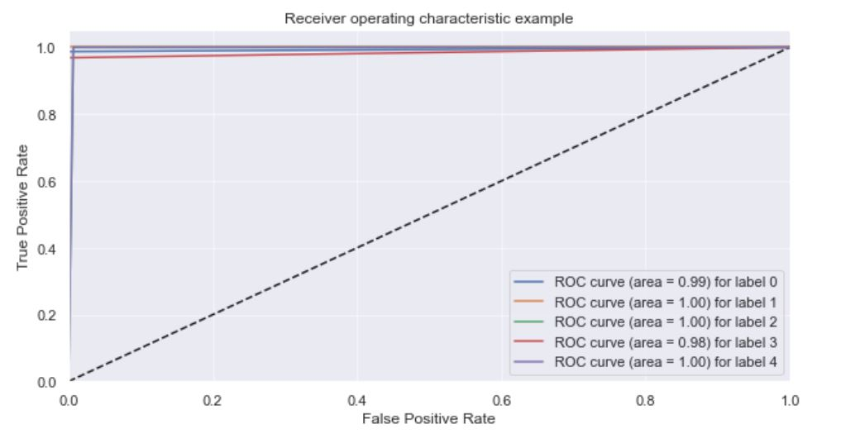
ROC Curve Of LSTM :

Slide 24
Merits:
Analysis can be performed on a required class text from a web news document like graph of performance of India in Olympics based on web news over a decade.
web news classification can improve the quality of web search during engines crawls.
Web page classification can also be used by cyber security applications by blocking web pages with malicious content before they are displayed by the user.
Demerits:
An article containing more than one type of class can not be identified by our models.

Slide 25
Conclusion and Future Scope:
We conclude that this project presents the classification of web news in a website using the applications of ML algorithms. Almost all the three ML models gave good accuracy values but the most accurate one is LSTM model.
In future our project will extract videos from web such as movies,videos etc. Also user can get live updated news from internet. User will be added his own interested news and share that news with another user. User will be personalised his own category( can add new categories too) as per his demand and provide more security for each user. And also we will try to use regional languages which are user friendly.
Also the major and interesting thing is adding analysis to the data for the user.

Slide 26
References:
[1]https://www.academia.edu/2038312/Fast_webpage_classification_using_features
[2] Surajit Chandhuri , Umeshwar Dyal ,“ An overview of data warehousing and OLAP technologies” Published in ACM Sigmod record, Vol. 26, Issue 1, pp. 65-74, USA, 1997
[3] Thorsten Joachims,“Text Categorization With Support Vector Machines: Learning with many relevant features,” Published in: European Conference on Machine Learning (ECML 1998), Lecture notes in Computer Science Book series Springer Publications, Vol. 1398, pp. 137-139, 1998
[4] Hyeran Byun Pattern Recognition with Support Vector Machines, First International Workshop, SVM 2002, Niagara Falls, Canada, August 10, 2002, Proceedings
[5] Chee-Hong Chan Aixin Sun Ee -Peng Lim ,“ Automated Online News Classification with Personalization,” 4th International Conference on Asian Digital Libraries (ICADL2001), Bangalore, pp. 320-329, 2001
[6] Daniel I. Morariu, Lucian N. Vintan, Volker Tresp, “ MetaClassification using SVM Classifiers for Text Documents”, World Academy of Science, Engineering and Technology 21, pp. 15-20, 2006
[7]D. Morariu, R. Cre¸tulescu, L. Vin¸tan ,“Improving a SVM Meta-classifier for Text Documents by using Naïve-Bayes,” Int. J. of Computers, Communications & Control, Vol. 3, pp. 351-361, 2010.
[8] Mr. S.P Deshpande, Dr. V.M Thakre,“ Data mining system and Applications: A review,” In International Journal of Distributed and Parallel System (IJDPS), Issue 1, Vol. 1, pp. 32-44, 2010
[9] Mita K. Dalal, Mukesh A.Zaveri,“Automatic text classification: A technical review,” In International Journal of Computer Applications, Vol. 28, Issue 2, pp. 37-40, 2011.
[10] Yiming Yang, Xin Liu,"A re-examination of text categorization methods,” Caenegie Mellon University Pittsburg, PA 15213- 3702, USA, Vol. 18, Issue 2, 2012.
[11] Rama Bharath Kumar, Bangari Shravan Kumar, Chandragiri Shiva Sai Prasad,“ Financial news classification using SVM,” International Journal of Scientific and Research Publications, Vol. 2, Issue 3, pp. 1-6, 2012

Slide 27
THANK YOU

